Slide 1


Code Visualization
Johan van den Muijsenberg
Notes:
This presentation is about code visualization. Code visualization techniques are useful in understanding and analyzing software and become more productive.

Slide 2
Software Quality
Software with the required functionality and performance with an acceptable defect level delivered within an agreed timeframe
Notes:
We want to deliver high quality software. What does that mean and what is important ?

Slide 3


Fact
Defects
Domain knowledge
Impact Analyses
McCabe complexity
Architectural complexity
Notes:
The first is aspect is acceptable defect level. Things that impact defect level are domain knowledge, being able to do impact analysis and code complexity.
The fastest way to product improvement as measured by reduced faults is to hire people who are knowledgeable about the domain of the product. Remember, lack of knowledge tended to dominate the underlying causes. The fastest way to increase the knowledge needed to reduce faults is to hire knowledgeable people.
One of the least important ways to improve software developments is to use a “better” programming language. We found relatively few problems that would have been solved by the use of better programming languages.
Techniques and tools that help to understand the system and the implications of change should be emphasized in improving a development environment. Remember that knowledge-intensive activities tended to dominate the means of prevention.
From the book ‘Making Software’ chapter 25. Where Do Most Software Flaws Come From?. See https://www.oreilly.com/library/view/making-software/9780596808310/ and https://dsmsuite.github.io/documents/sturtevant_050613.pdf

Slide 4
Fact
Productivity
Architectural complexity
Higher level languages
Notes:
The second aspect is productivity. Code complexity has a negative impact.
See https://dsmsuite.github.io/documents/sturtevant_050613.pdf

Slide 5

What matters
Naming | Complexity
Cohesion | Coupling
ABC
Notes:
What is important to write clean code ?
Naming
Names should best reflect the problem domain.
Visibility: High – Visible at module level.
Complexity
Methods should be easy to understand.
Visibility: High – Visible at module level - Deep nesting.
Metrics: Cyclomatic complexity.
Value: CC<10
Cohesion
Modules should be small and follow the single responsibility principle.
Visibility: High – Visible at module level - Long files.
Metrics: Lines of code or lack of cohesion.
Value: LOC<1K
Coupling
Low coupling and dependencies towards abstractions.
Visibility: Low - Information is spread across many files/modules.
In this presentation the focus will on using code visualization techniques for visualizing software dependencies as this is the least visible quality attribute.

Slide 6
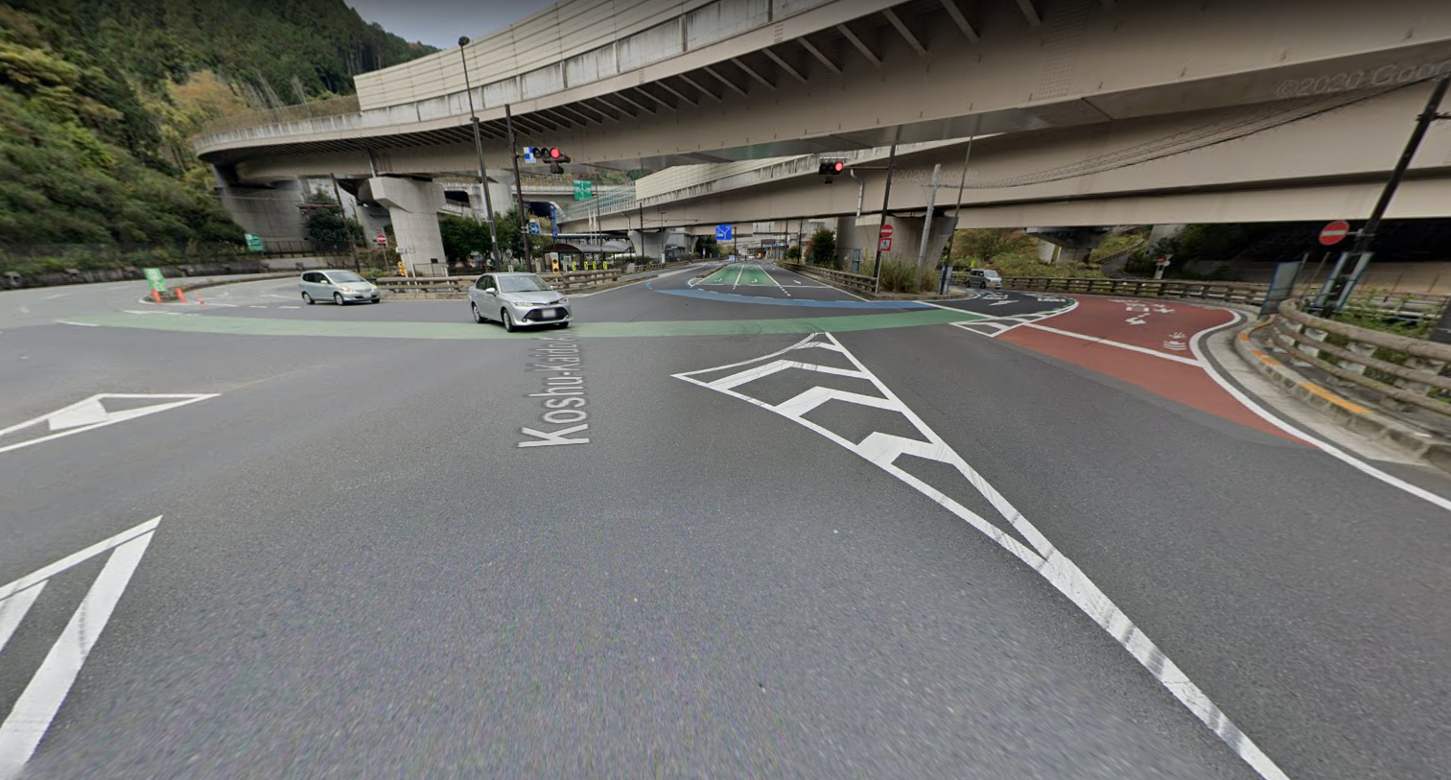
Takaosan Interchange, Hachioji, Japan
Notes:
Trying to understand dependencies by looking at the dependencies of a single module does not give much insight.
It is like looking from a single view point at this intersection. One can sense it is complex, but to truly understand its complexity one needs at high level view.

Slide 7
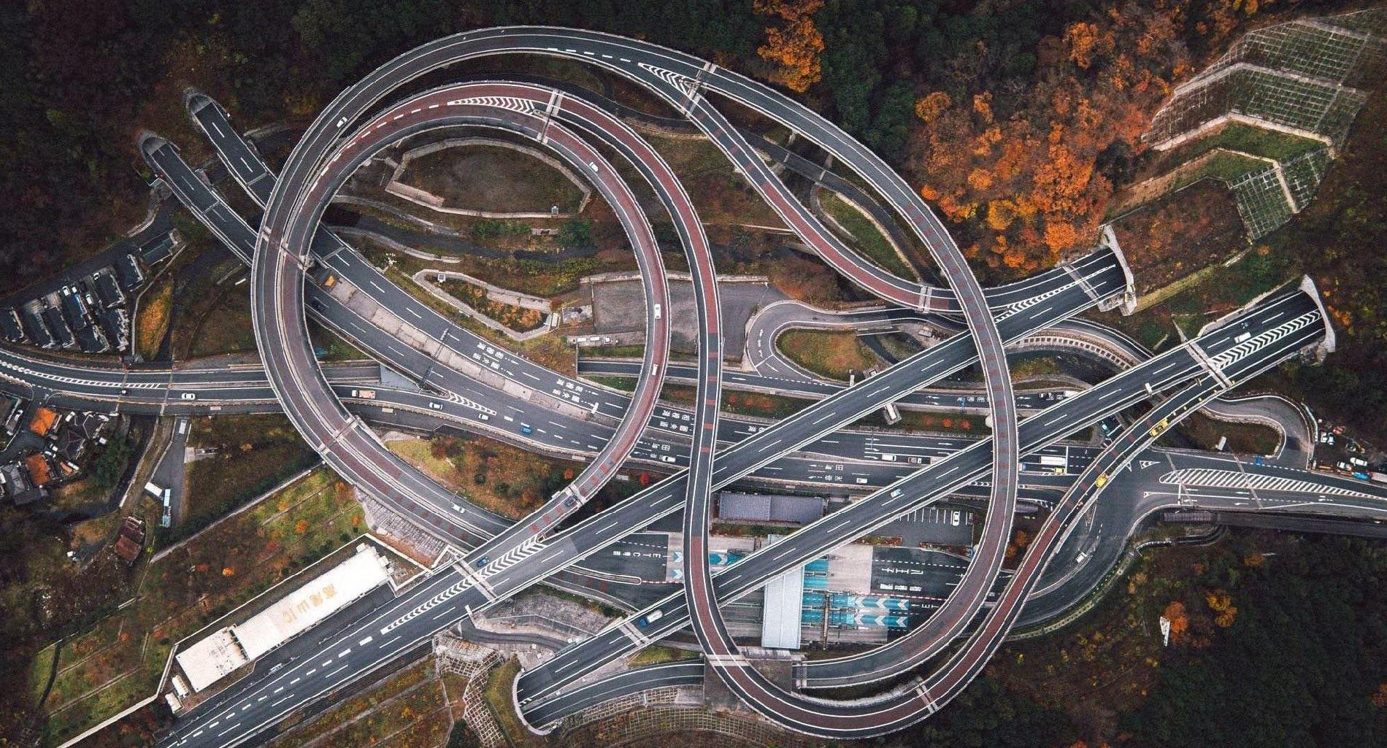
Takaosan Interchange, Hachioji, Japan
Notes:
This is the same crossing from a higher level perspective. Now only clearly sees the complexity of the interchange. The situation is similar for software.
The question is what is the best way to present the often very complex dependencies of a software system.

Slide 8
Software Dependencies
Impact for different roles
Notes:
Let us first look at some daily activities for different software development roles and how software dependencies affect these activities.

Slide 9

As developer
Notes:
We start with the developer role.

Slide 10
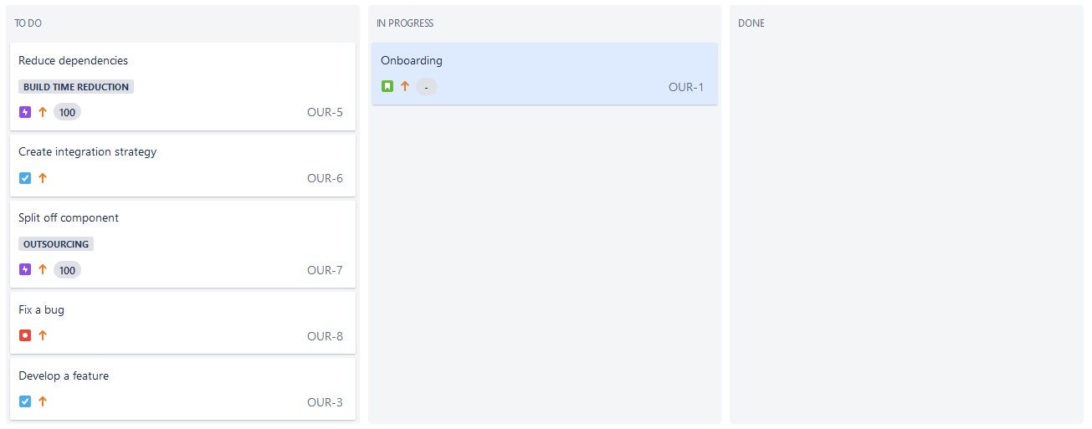
Notes:
You just started as a new developer on the team and as a first onboarding activity you want to get a high-level view of the software you will be working on.
So you look at the software architecture documentation, but there is none, it is obsolete or it is a such a high level that is does not help you in your daily work.

Slide 11
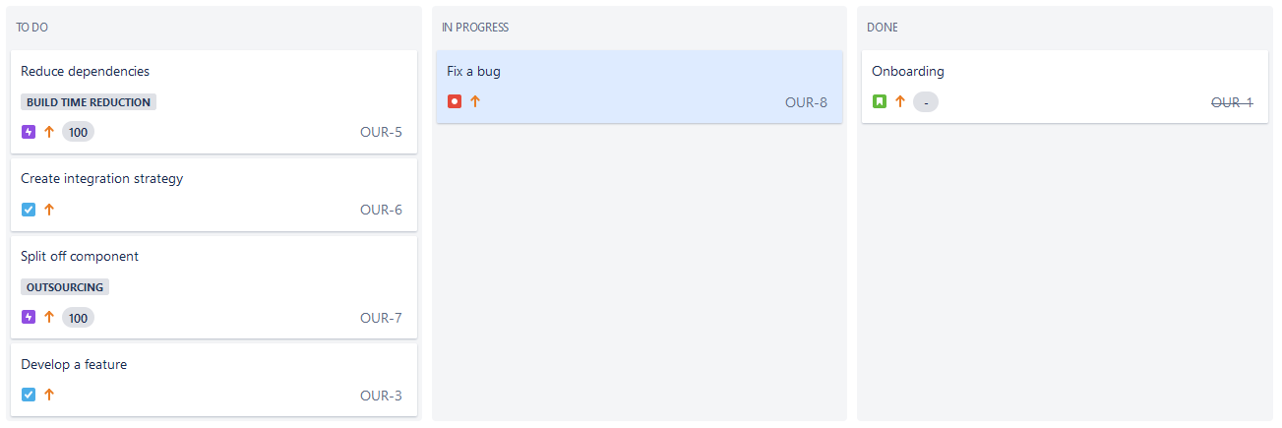
Notes:
After onboarding you start you first task to fix a defect, but notice it is very hard due to the complex software dependencies.

Slide 12

Fact
Modularization - The effort to locate a fault reduced by 50% for simple faults, and 20-25% for complex faults
[Accenture and Infosys study]
Notes:
Having a clean code structure helps fixing defects quicker.
See https://structure101.com/2012/08/02/surveys-show-that-software-structure-matters/

Slide 13
Notes:
You thought you solved the defect, but now its again back. What happened ?

Slide 14
Fact
Methods with higher cyclomatic complexity have a higher bad fix probability
[Aivosto]
Cyclomatic complexity | Bad fix probability
1-10 | 5%
20-30 | 20%
>50 | 40%
approaching 100 | 60%
Notes:
https://www.aivosto.com/project/help/pm-complexity.html

Slide 15
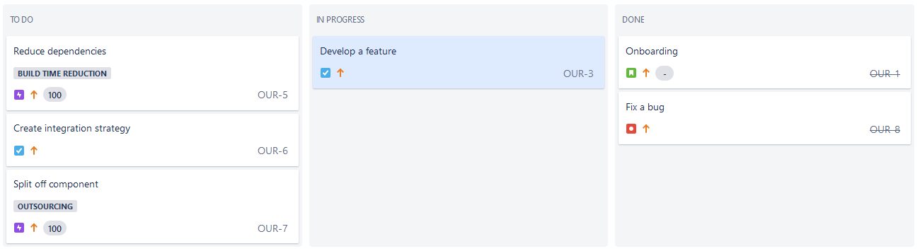
Notes:
After this you start implementing a new feature. You need extend the functionality of one source file. It seems like a simple task.

Slide 16
In-cycle components averaged 80% more bugs than the non-cycle components
[Using Hubs and Cyclicality to Relate Software Architecture and Quality, Tyson R. Browning et al, 2013]
Fact
Notes:
You discover that a few components which would be involved in this new feature are involved in a cyclic dependency.
You would like to resolve this, because it increases the defects to be expected. It makes it also hard to unit test the code.

Slide 17
More defects - Increase up to 8.3X
[Cost of Complexity – Dan Sturtevant]
 | Very High | 5.86 | 8.39 | 13.66 | 18.42
 | High | 5.78 | 8.28 | 13.47 | 18.18
 | Mid | 4.49 | 6.44 | 10.47 | 14.13
 | Low | 2.22 | 3.18 | 5.18 | 6.98
 |  | Peripheral | Utility | Control | Core
McCabe
Classification
Fact
Architectural Classification
Notes:
You discover that the same components which would be involved in this new feature also have many in and outgoing dependencies.
You would like to resolve also this, because it increases the defects to be expected.
https://dsmsuite.github.io/documents/sturtevant_050613.pdf

Slide 18

Fact
Developers spend up to 50 percent of their time searching for information
[Ko et al. 2007; Murphy et al. 2006]
Notes:
The investigation to reduce the technical debt takes quite some time due to the complex structure of the code. This is not uncommon.
50% is a significant amount of time. It would good if we could make this process more efficient. It is time consuming and the results are often disappointing.
In a study ‘in the comprehension of software comprehension’’ I read:
“Avoid comprehension
Another similar interesting aspect calling for further investigation is the avoidance of a deep understanding of the source code by observed developers. One potential reason is that software comprehension is a hard and time consuming task and consequently is avoided whenever possible.
Developers try to avoid comprehension whenever possible focusing rather on the expected output of the main development task such as extending a functionality or ﬁxing a bug.
Developers try to avoid comprehension by cloning pieces of code if they cannot comprehend all possible consequences of changes.”
This behavior leads to increased technical debt and will make future effort even more difficult.

Slide 19
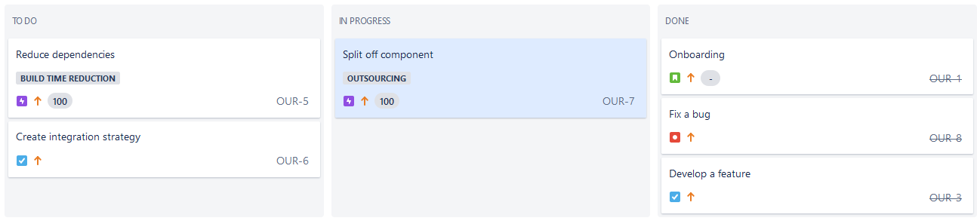
Notes:
Despite all difficulties you were able to successfully fix the defect and implement the feature.
You are now assigned a more complex task.
Management wants to outsource a part of the software your team develops, because you have insufficient resources.
You contact they software architect from some more background information.

Slide 20
A
B
C
D
E
F
G
Notes:
According to the software architect the current architecture consists of the following components and major dependencies.

Slide 21
A
B
C
D
To be outsourced
E
F
G
Notes:
Based on the input of the software architect, you aim to migrate components F and G to a separate source code archive and out source them.
You make an agreement with the external supplier and for your own team planning you take into account the reduced maintenance effort as result of this out sourcing.

Slide 22
A
B
C
D
Required but overlooked by architect
E
F
G
Notes:
After you started the actual out sourcing project, you discover things are not that easy.
The software architect forgot an important design aspect in the software architect document provided to the developers as guidance.
To resolve this issue a dependency from G to D was required. A developer added that to the implementation, but never gave feedback to the software architect, so he was not aware of this.
.

Slide 23
A
B
Quick fixes
D
Quick fixes
C
E
F
G
Notes:
As you dive deeper you find out things are even more difficult than anticipated.
Two other colleague also introduced some incorrect dependencies, while working under enormuous time pressure. They never fixed this.
It will be hard to isolate the two components and will likely not be able to meet the deadline.
Having an accurate image of the actual and not just the documented dependencies would have helped you to better estimate the work and risk involved.

Slide 24

Immobility
Notes:
The code for the components suffers from immobility. A term coined by Uncle Bob (Robert C. Martin).
It means the software can not be isolated, so not reused across projects.
It is caused by the software being tightly coupled to other parts.

Slide 25
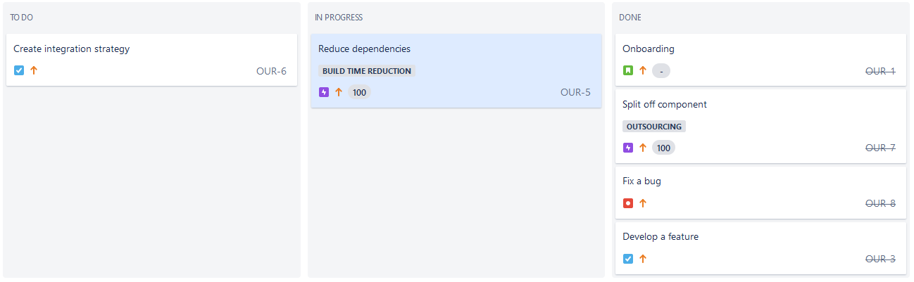
Notes:
After the refactoring task, you are assigned a next task to reduce build time. A full rebuild takes about an hour.
You discover that build time is so high, due to the many include dependencies. Untangling the software is a very complex task, which would take many months.
At short term no improvement is possible so the developers have to be patient for the time being.

Slide 26


Slide 27
As tester
Notes:
Now let us discuss the tester role

Slide 28
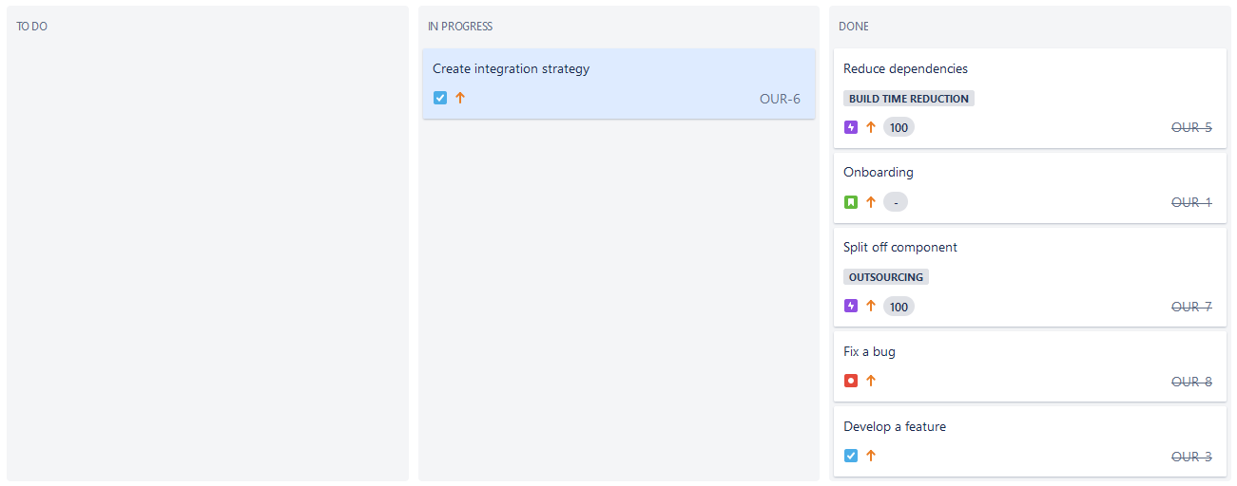
Notes:
You are assigned to create an integration strategy for the software.

Slide 29
A
5
B
5
1
4
C
D
E
3
1
2
F
G
Notes:
You come up with following integration order again based on the software architecture document.

Slide 30
A
?
B
?
?
?
C
D
E
?
?
?
F
G
Notes:
We know the software architecture document was incorrect. That means your integration strategy will not work unfortunately.
Having an accurate image of the actual and not just the documented dependencies would have helped also you to better estimate the work and risk involved.

Slide 31
As architect
Notes:
Now let us discuss the role of the software architect.

Slide 32
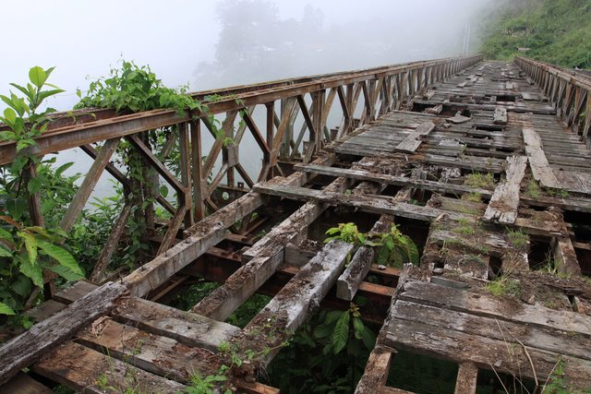
Software Rot
Notes:
Want often see happening is that the quality of the software degrades over time, It is what Robert C. Martin calls software rot.
The software still meets its requirements (you can use the bridge to reach the other side), but its quality attributes are not at the required level (you should be extremely careful).

Slide 33
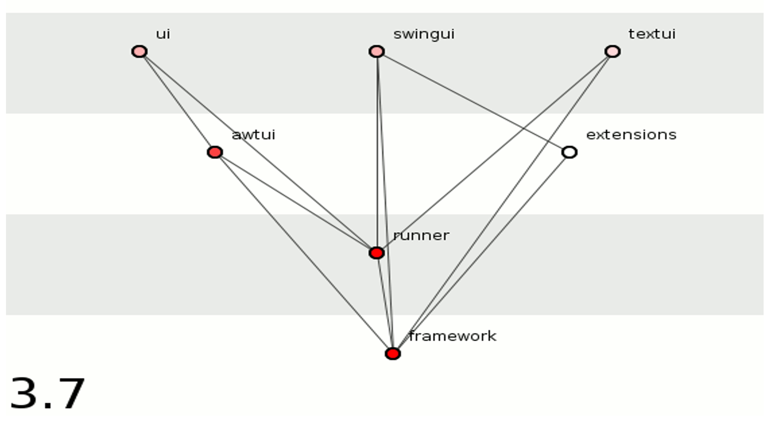

Notes:
The initially clean software architecture degraded over time. You once saw this animation of the evolution of Junit and you own situation reminds you of that animation.

Slide 34
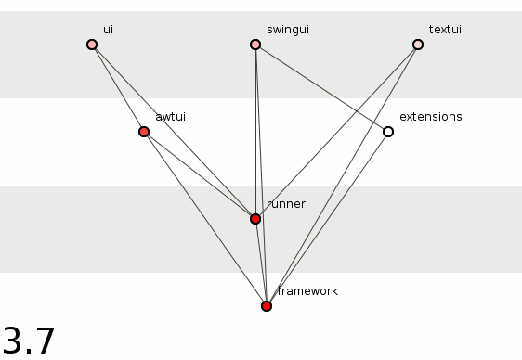
Notes:
Let us have a look at that animation.
You observe the following qualitied have degraded over time.

Slide 35

Rigidity
Notes:
It has become increasingly hard to add new features.
The reason is many software elements are tightly coupled instead of properly decoupled.

Slide 36

Fragility
Notes:
You also notice that the software has become brittle. Now and then it breaks apart after having made a simple change.
All this is caused by poor management of the software dependencies.

Slide 37

Lower productivity - 50% decline for complex code
[Cost of Complexity – Dan Sturtevant]
Fact
Notes:
You also notice it has become harder to make progress.
https://dsmsuite.github.io/documents/sturtevant_050613.pdf

Slide 38

Refactoring
Notes:
You decide that architecture level refactoring is required to improve the situation. It will require of lot of work, so effort needs to be spread across time, because you still need to deliver new software releases coming months.
It is like in road reconstruction where roads are changed while traffic can continue.

Slide 39
Fact
In large software projects drastic changes should not be made without considering continuity from the former architecture.
[Architecture Migration using DSM in a Large Scale Software Project, Takashi Maki, 2012]
Notes:
In large software projects drastic changes should not be made without considering continuity from the former architecture to limit risk.
To be able to do this you need accurate and up to date information about the actual dependencies in the software.

Slide 40

Intentional architecture
Defines a set of purposeful, planned architectural strategies and initiatives, which enhance solution design, performance, and usability and provide guidance for inter-team design and implementation synchronization.
Emergent design
Provides the technical basis for a fully evolutionary and incremental implementation approach. This helps developers and designers respond to immediate user needs, allowing the design to evolve as the system is built and deployed.
Notes:
You have heard about the scaled agile framework where the have something called intentional architecture and emergent design.
The emergent design helps developers to respond to immediate user needs and can act as feedback to the architect for things he missed.
To be able to use this there needs to be a way to look at the source code at a more abstract level as you have no time you browse through all the code.

Slide 41




Intentional
Architecture
Define
Guidance
Adjust
Software
Architect
Fix Source Code
Software
Developers
Develop
Feedback
Abstract
Emergent
Design
Source
Code
Notes:
Code visualization can help in providing this abstraction of the source code.

Slide 42
As manager
Notes:
Now let us look at the role of the manager.

Slide 43

Notes:
You recently noticed some software team members leaving the company.

Slide 44

Fact
Higher staff turnover - 10x increase in voluntary and involuntary terminations for complex code
[Cost of Complexity – Dan Sturtevant]
Notes:
It might be related to the complexity of the code.
https://dsmsuite.github.io/documents/sturtevant_050613.pdf

Slide 45
Impact
Cost of unmanaged code complexity can be huge
Notes:
The conclusion is that the impact of code complexity can be huge and many people are impacted by it.

Slide 46
Visualization Techniques
Notes:
The next step is to have a look at available code visualization techniques.

Slide 47
Fact
Industry developers do not use program comprehension tools such as visualization, concept location or software metric tools.
[On the Comprehension of Program Comprehension, Walid Maaley et al 2014]
Notes:
Although source code visualization is helpful , surprisingly these kind of tools are not often used by developers

Slide 48
Lines and Boxes
Notes:
The most common visualization technique is lines and boxes.

Slide 49

Notes:
UML is best known lines and boxes notation

Slide 50
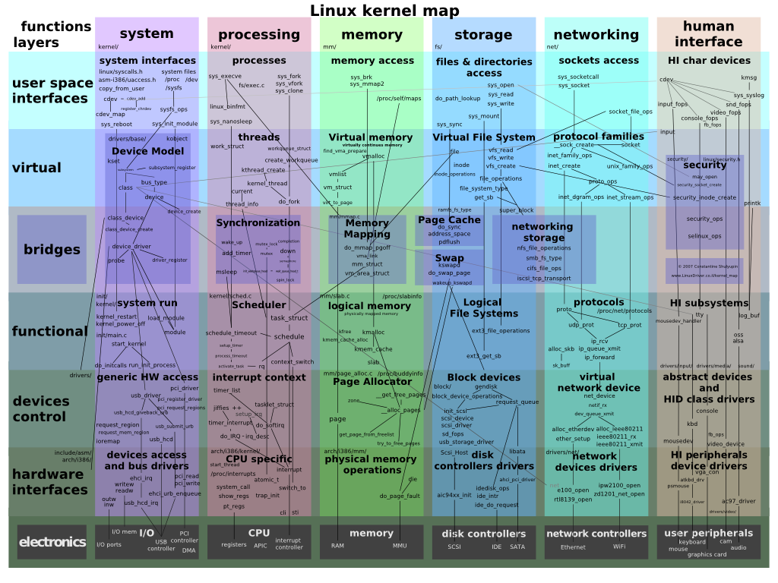
Notes:
But at some point the diagrams becomes too cluttered. Lines and boxes visualization techniques does not scale very well.

Slide 51
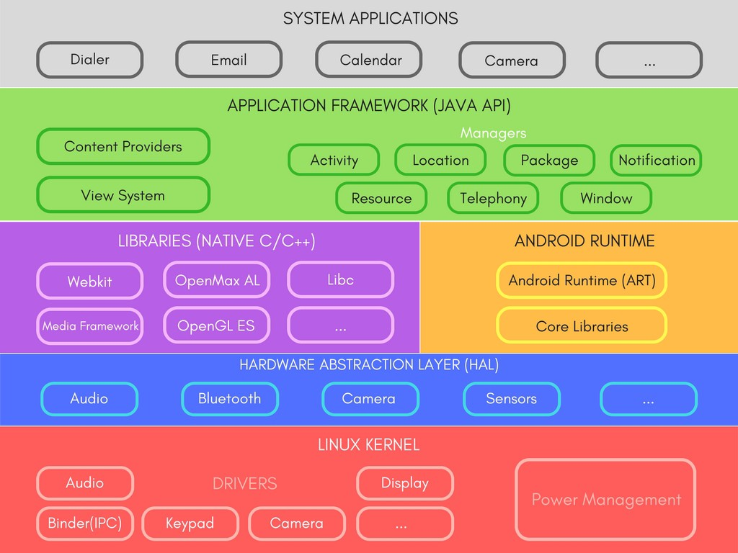
Just Boxes No Lines
Notes:
And that is why you often see only boxes being shown in a layered order.

Slide 52
“The highest-level breakdown of a system into its parts; the decisions that are hard to change”
[Patterns of Enterprise Application Architecture, Martin Fowler]
“.... software elements, the externally visible properties of those elements, and the relationships among them”
[Software Architecture in Practice (2nd edition), Bass, Clements, and Kazman]
Notes:
By hiding the dependencies for the diagram to avoid clutter you are omitting a vital aspect of the software architecture definition.

Slide 53
Design Structure Matrix
Notes:
An not so common visualization technique is a design structure matrix.
A design structure matrix (DSM) consists of two parts
A matrix to visualize dependencies
Algorithms which can be applied on the matrix to discover e.g. layering in the software.

Slide 54
Many dependencies
Wrong direction
UML
Skip layer
Cycle
Not used
Notes:
First the design of a small example software application is shown in UML. Then step-by-step it is explained how using a DSM can help to understand and improve the design.
The design shown above intentionally contains the some typical design errors:
A cyclic relation between A4 and A5.
A relation from A3 to P3 against the expected layering.
A relationship from P5 to D3 that skips a layer.
An unused element A6 without incoming relationships.
A element U2 with many in- and outgoing relationships (not shown to avoid cluttering the diagram)

Slide 55
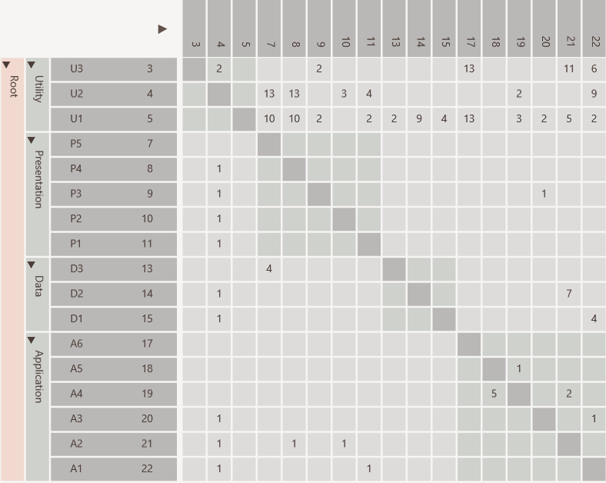
Same rows and columns
Definition
Identity line
P5 uses D3
Value indicates strength
Hierarchy
Notes:
The figure above shows the same design in a DSM.
The DSM consists of a matrix with the same elements in the rows and columns.
The hierarchy of packages and elements is visible on the left.
The relations between the elements are shown in the cells.
DSMs have a few key strengths

Slide 56
Dependencies from A1 to U1, U2 and U3
individually
Scalable
Notes:
The first key strength is scalability.
In a DSM, the hierarchy can also be folded in whole or in part. The relational strengths of the collapsed cells are simply combined. As a result, the DSM will become more compact, but will still remain correct in terms of content.
In this way it is possible to display a system with thousands of elements and still keep the overview.

Slide 57
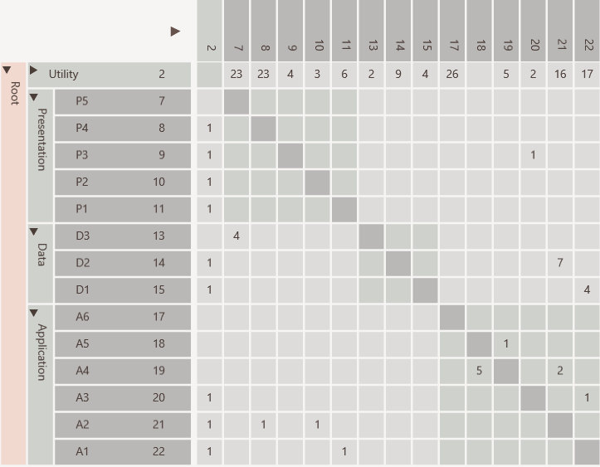
Dependencies from A1 to U1, U2 and U3
aggregated
Scalable

Slide 58
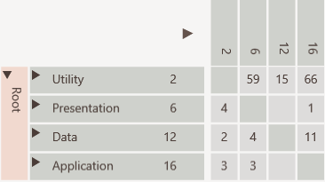
Scalable
All dependencies between Application and Utility collapsed

Slide 59
Many dependencies above identity line
Discovery
Notes:
The second strength is architectural discovery.
By applying a partitioning algorithm on the DSM, the layering of the software can be discovered. Such an algorithm tries to reorder the DSM in such a way that as many relationships as possible come under the diagonal.
Advanced algorithm can also find clustering in large groups of elements.

Slide 60
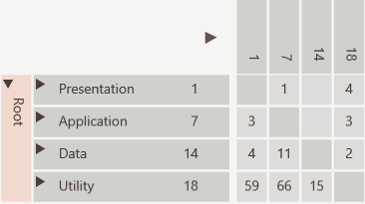
Consumers to top
Cycle easily visible
Discovery
Providers to bottom
Notes:
After partioning elements with many inbound relationships (providers) have shifted to the bottom, while the elements with many outgoing relationships (consumers) have shifted to the top.
Cyclic relations can be easily spotted, because the type of relations remain above the diagonal.
The figure above shows that there are problems with the layering:
The presentation layer directly uses the data layer, thereby skipping a layer. This is caused by P5 in the presentation layer directly using D3 from the data layer.
The application layer uses the presentation layer, which goes against the expected layering. This is caused by A3 in the application layer using P3 in the presentation layer, which is violates the expected layering.
The utility layer uses all other layers, which goes against the expected layering. This is caused by U2 using all layers.

Slide 61
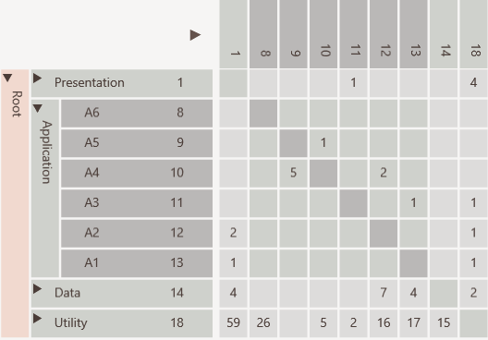
Not used
Discovery
Cycle
Public interface
Encapsulated
Notes:
A DSM makes it easy to recognize dependency patterns.
The DSM above shows that:
elements A1 and A2 are the public interfaces towards the presentation layer.
elements A3, A4 and A5 are internal elements of the application layer, because they are used inside the application layer.
element A6 is likely an unused element.

Slide 62
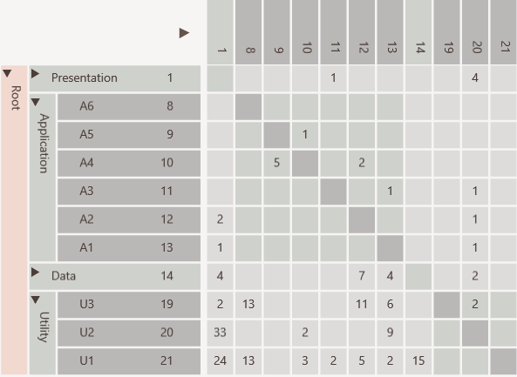
Discovery
Elements used in entire software like utilities and data access objects
Notes:
The DSM above shows that elements U1, U2 and U3 are used throughout the software. This means they are a kind of utility elements.

Slide 63
Discovery
U2 is a change propagator because has many in and out going dependencies
Notes:
The DSM above shows that element U2 is problematic, because in addition to incoming relationships it also has outgoing relationships. It is called a change propagator. Changing this elements has impact on many pieces of the software.

Slide 64
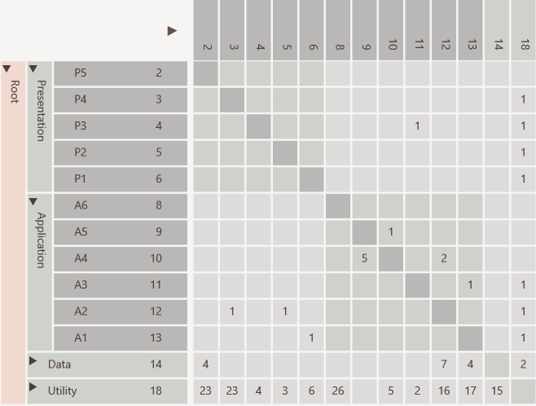
Hierarchical cycle due to
A3 using P3
which violates layering
Refactoring
Notes:
A DSM can be used to improve the dependency structure. One can think of:
Removing cyclic dependencies.
Improving the cohesiveness of a component by move elements to other component were the have stronger relations.
In the matrix we can move an element to another component or layer, combine it with other elements or split and then recalculate all dependencies to see if this yields a better dependency structure.
In our example we had a relation from A3 to P3 against the expected layering. Now suppose after inspecting the source code we discover that P3 does not contain user interface but application code.

Slide 65
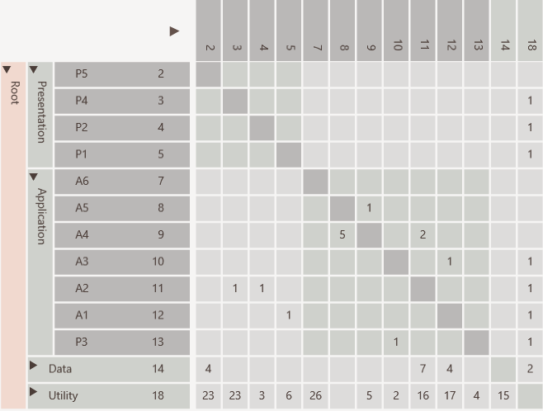
Cycle removed
Refactoring
Moved P3
Notes:
Therefore we decided to move it from the presentation to the application layer.
After recalculating the dependencies it can be seen that the cyclical relationship between the presentation and application layer has disappeared.
The advantages of such an impact analysis are particularly evident in improvement scenarios that take place at the architectural level and thus affect multiple components. Without the use of a DSM, such analysis are unreliable, because the intended and the actual software architecture often do not match.

Slide 66
Software Architecture
DSM can bridge gap
Key concepts
Communication
Low level details
Source Code
Notes:
A DSM can be used to bridge the gap between high level conceptual documents and the source code.

Slide 67

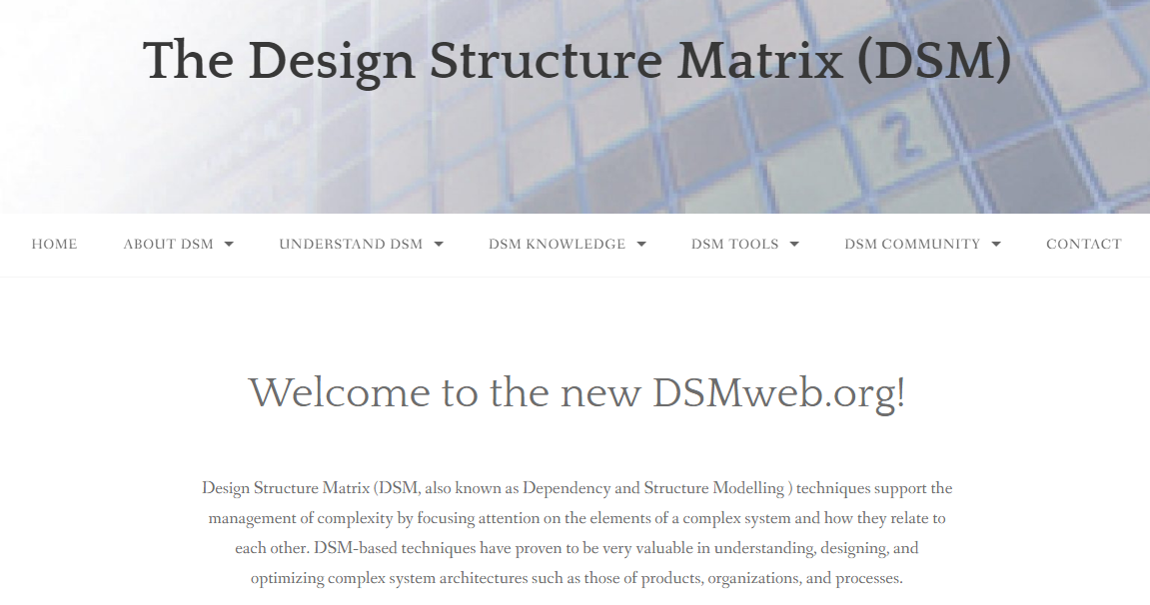
References
Notes:
If you need more background you can use these references. Note that both are not geared specially towards software.

Slide 68
Treemap Metrics Visualization

Slide 69
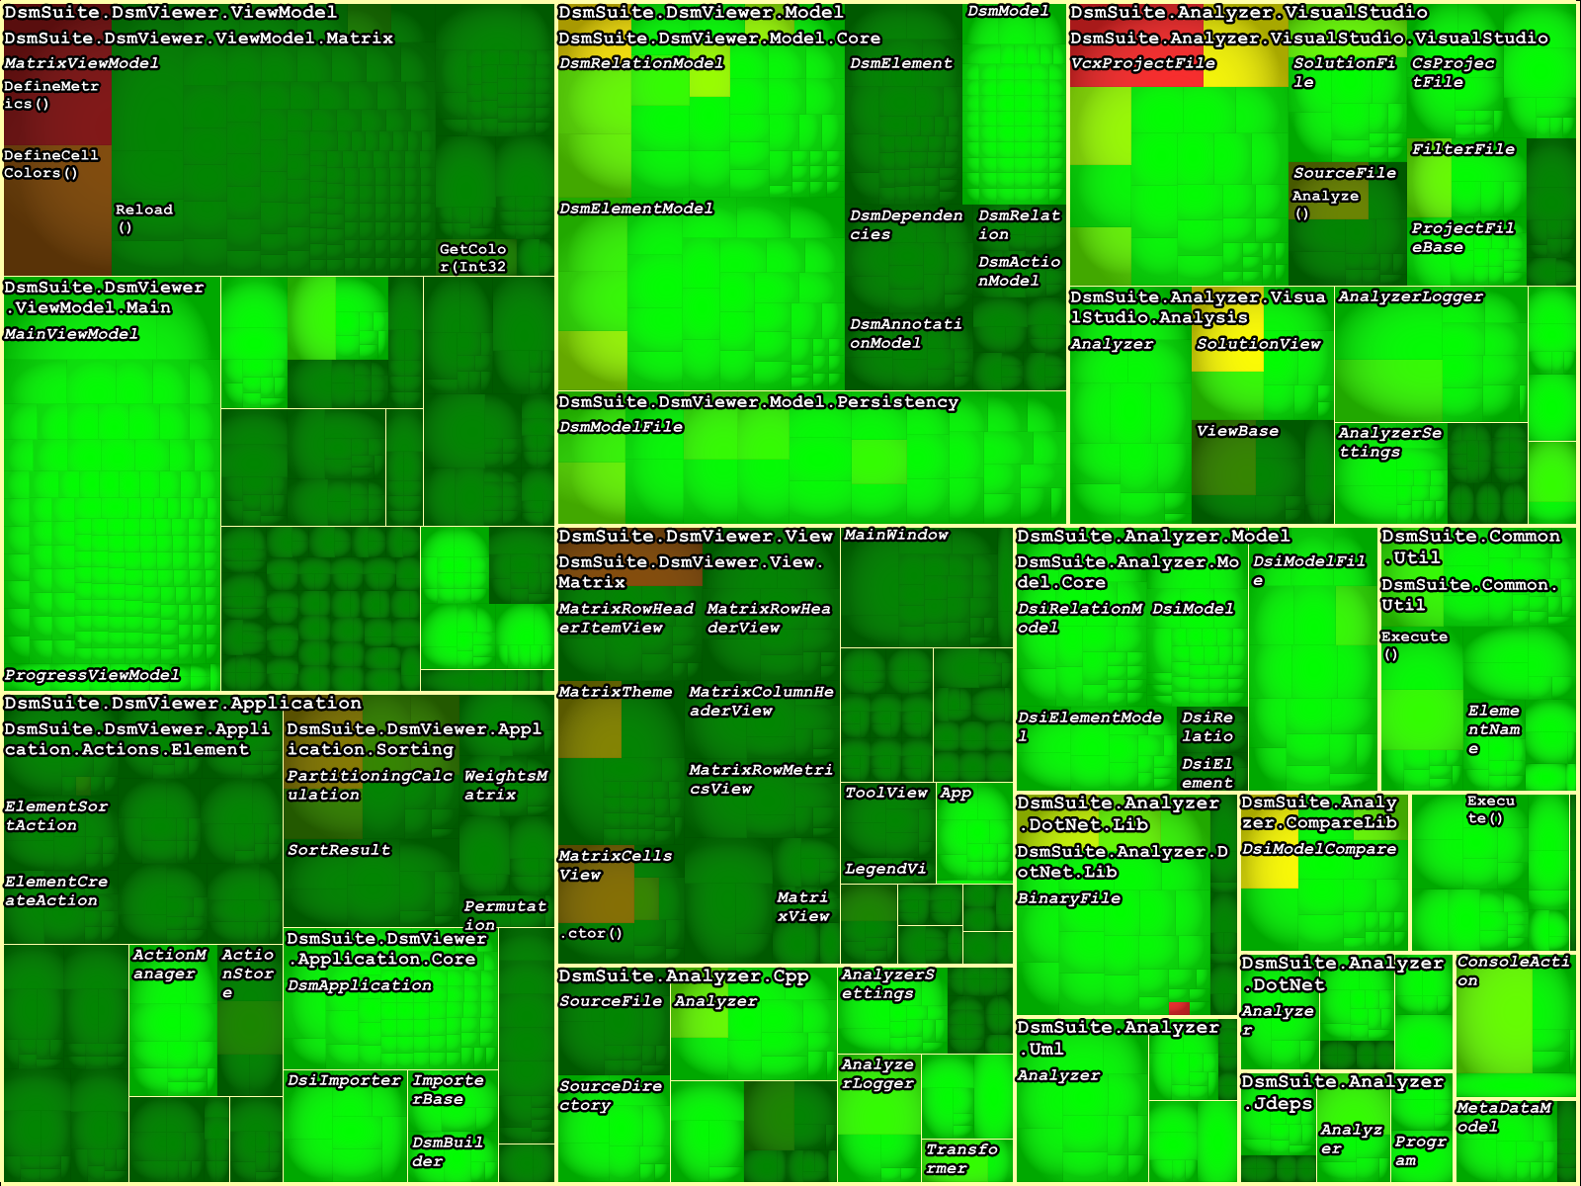
Notes:
Often used to visualize metrics, where the size of element often represents the lines of code and the colour a quality attribute.

Slide 70
Code City Metrics Visualization

Slide 71
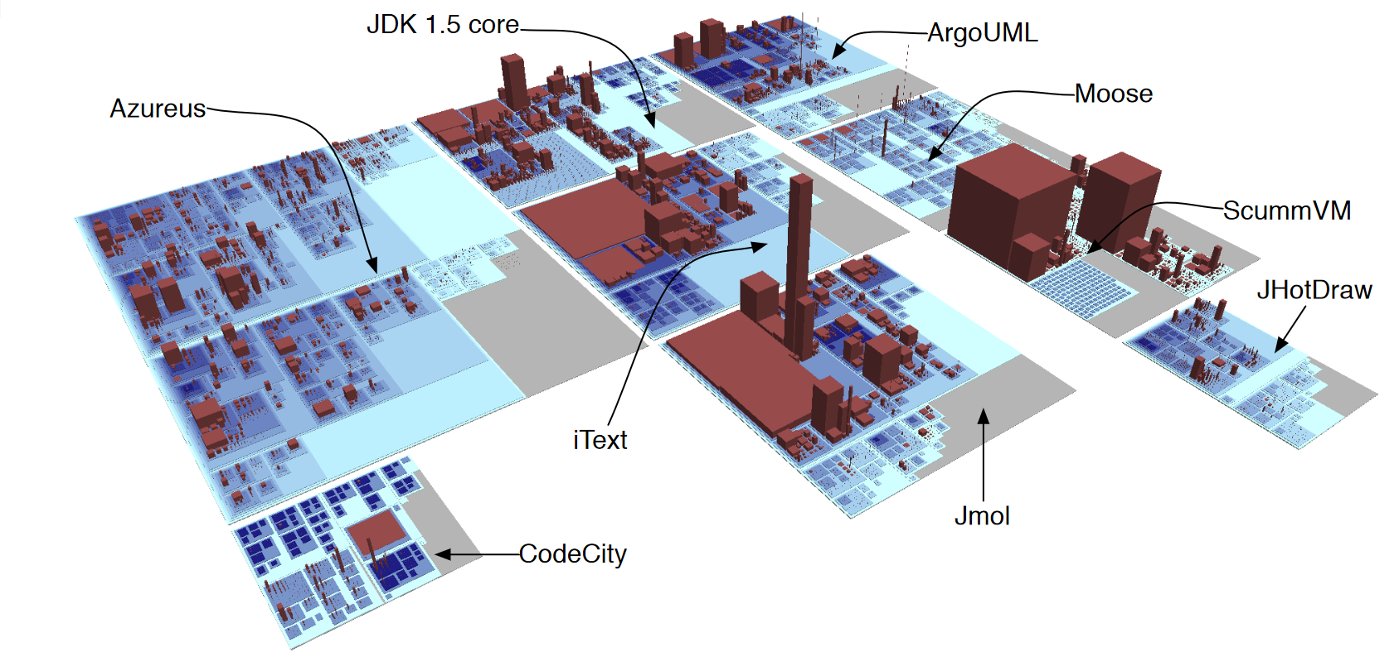
Notes:
Akind of extension of the treemap where multiple metrics values can e.g. linked to building color , height or area.
See:
https://softvis3d.com/
https://www.axivion.com/en/blog/codecity/
http://wettel.github.io/

Slide 72
Visualization Tools
Notes:
The next steps is to present code visualization tools. We will examine all tools by analyzing an open source code base. Analysis using the DSMSuite acts as a baseline.

Slide 73
Programming
Language
Checks
Design
Metrics
Dependency
Visualization
Notes:
These tools often combine showing aspects like:
Programming language violations
Module metrics and
Dependencies

Slide 74


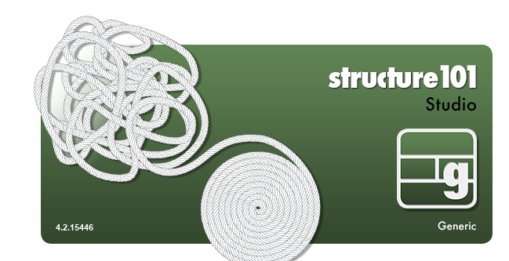




Notes:
These are some well known code visualization tools. Intelij is an IDE, but the Ullimate version has DSM functionality.
Most tools except SourceTrail are commercial tools.
There are no open source supporting DSM.

Slide 75
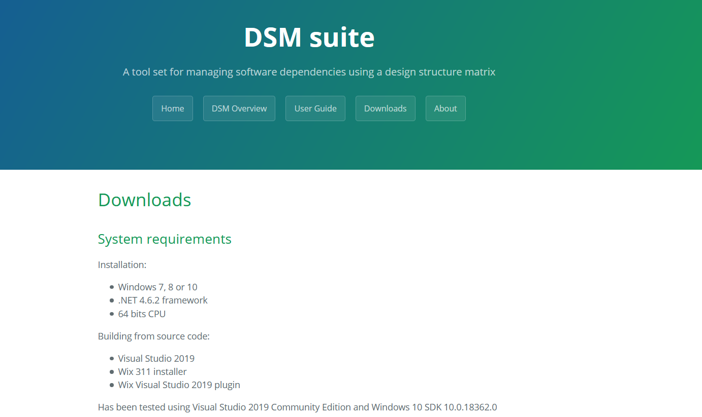
https://dsmsuite.github.io/
Notes:
That is why I decided to create my own.

Slide 76

Goal is open source DSM tool supporting multiple programing languages
Notes:
The goals were:
To provide a free open source tool suite for DSM visualization supporting at least dependency visualization and impact analysis.
To support a number of well known programming languages and environments.
To allow for easy extension to support other programming languages and environments.
To allow integration into a continuous integration build chain.

Slide 77
Comparer
Analyzer
Compares
Analyzer
Analyzer
Analyzer
DSI
file
Viewer
DSM
file
Analyzer
Exports
Imports
Visualizes
.Net, Java, C++, Visual Studio and UML
Conforms To
dsi.xsd
Third Party Analyzer
Notes:
An overview of the tool suite.

Slide 78
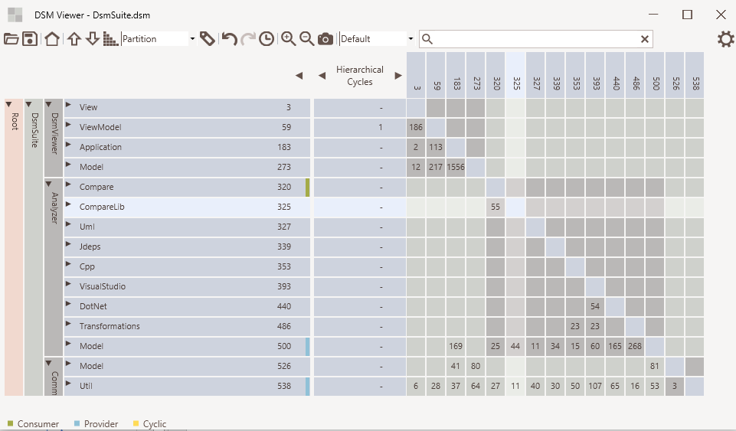
Notes:
And an overview of the user interface of the viewer

Slide 79




Road Ahead
Support standard graph formats Dot, GraphML, Gexf, Neo4J
Consider using data from SourceTrail which provides good code
analysis and is open source
Linux support (porting to QT?)
Support more and better portioning algorithms
yed
Notes:
For historical reasons the DSM suite is written in .NET. Future plans are to port it to QT so it can also be used on Linux.
Code analyzers might be discontinued and replaced by importing information from the open source tool SourceTrial, which supports dependency analysis at method level.
Supporting more extensive portioning algorithms is also desirable.
Using existing formats like GraphML and Gexf would allow visualization in other tools like Ne04J (support GraphML import), Yed and Gehphi.
An interesting aspect about the Gexf format is that it also supports time information when a node or edge was created or removed allowing visualization across time.

Slide 80
DsmSuite
Notes:
We first examine the DSMSuite itself.

Slide 81
Comparer
Analyzer
Compares
Analyzer
Analyzer
Analyzer
DSI
file
Viewer
DSM
file
Analyzer
Exports
Imports
Visualizes
What to expect
.Net, Java, C++, Visual Studio and UML
Conforms To
dsi.xsd
Third Party Analyzer
Notes:
The diagram provided on the web site tells us what to expect.
-An UI
-Several analyzers
-A compare tool

Slide 82
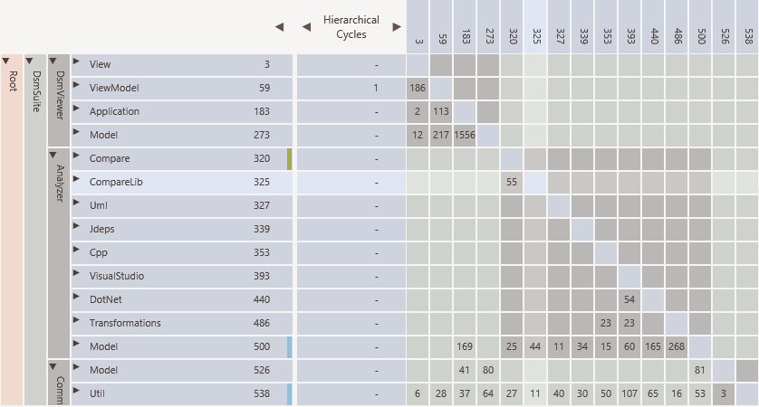
Notes:
When we look at the DSM we see what we expected. At this level there are no cyclic relations, which is to be expected for a tool developed with the aim to visualize and thereby manage software dependencies.
There is one cyclic relation at a deeper level. It is kept in to demonstrate how easy it is to track the actual dependencies causing this.

Slide 83
DEMO

Slide 84
Notes:
Next we demonstrate Enterprise Architect. It is a commercial UML tool, which has nice reverse engineering capacities.

Slide 85
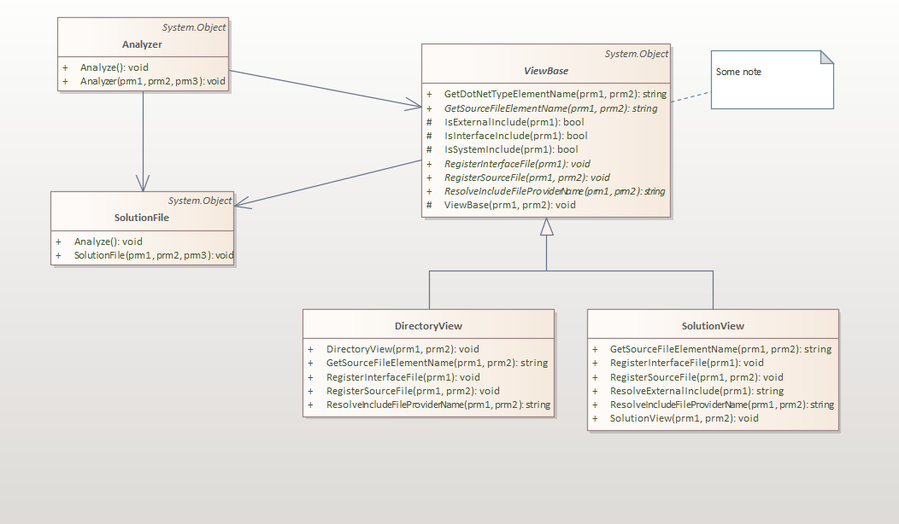
Notes:
It allows you to reverse engineer class diagrams from source code or binaries (.Net/Java).

Slide 86
DEMO

Slide 87
Notes:
The next tool is Ndepend. The tool is intended for .Net code. Similar tools exist for C++ (CppDepend) and Java (JavaArchitect).

Slide 88
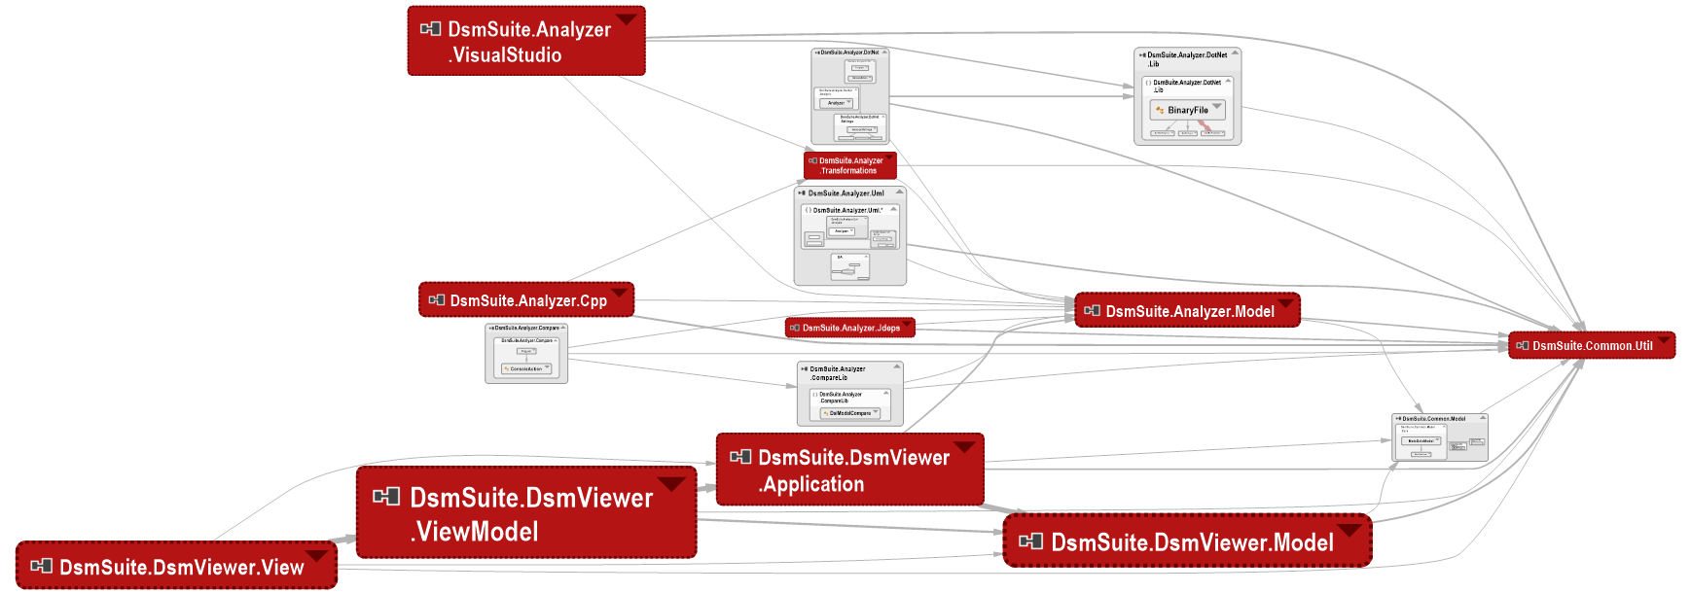
Notes:
It provides diagram showing relations between elements.

Slide 89
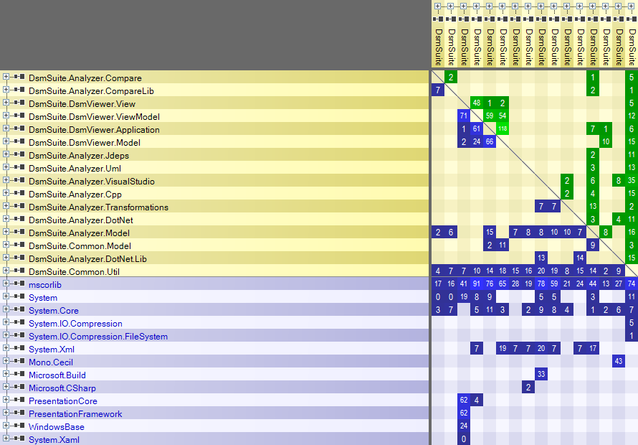
Notes:
It also supports DSM visualization.

Slide 90
Notes:
And treemaps to show metrics.

Slide 91
DEMO

Slide 92
ArgoUml
Notes:
As a next example we are going to look at ArgoUML whcoh is an open source UML tool.

Slide 93
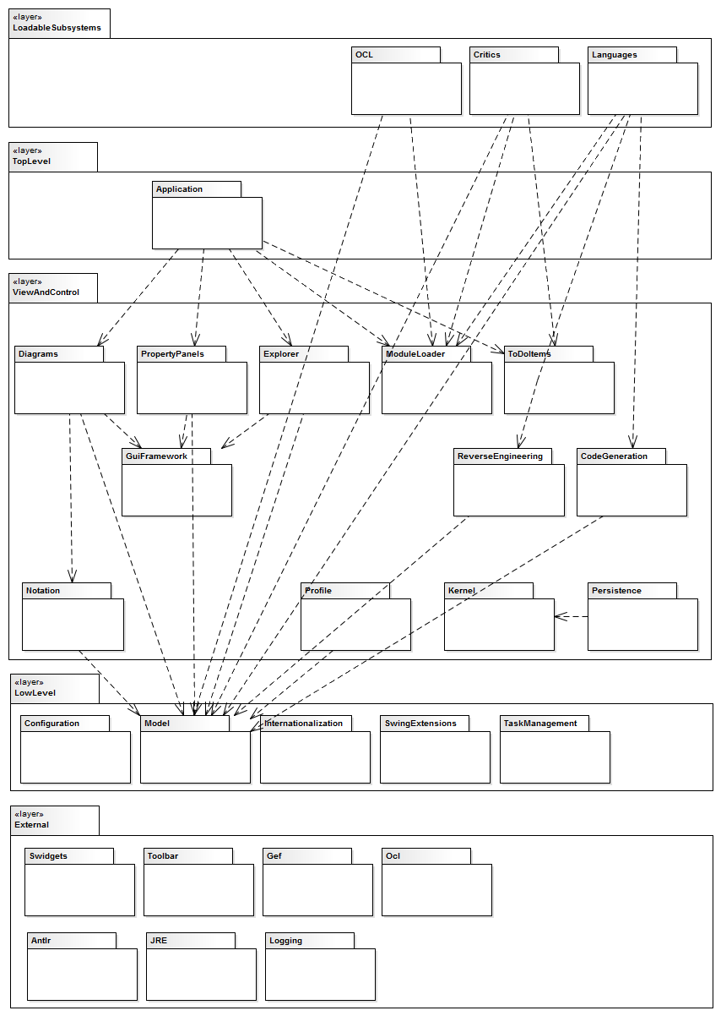
What to expect
Notes:
From the cookbook provided to support developes working on the code the following diagram can be extracted/
See https://dsmsuite.github.io/argouml/ which is a detailed analsysis I once did using the commercial DSM tool Lattix.

Slide 94
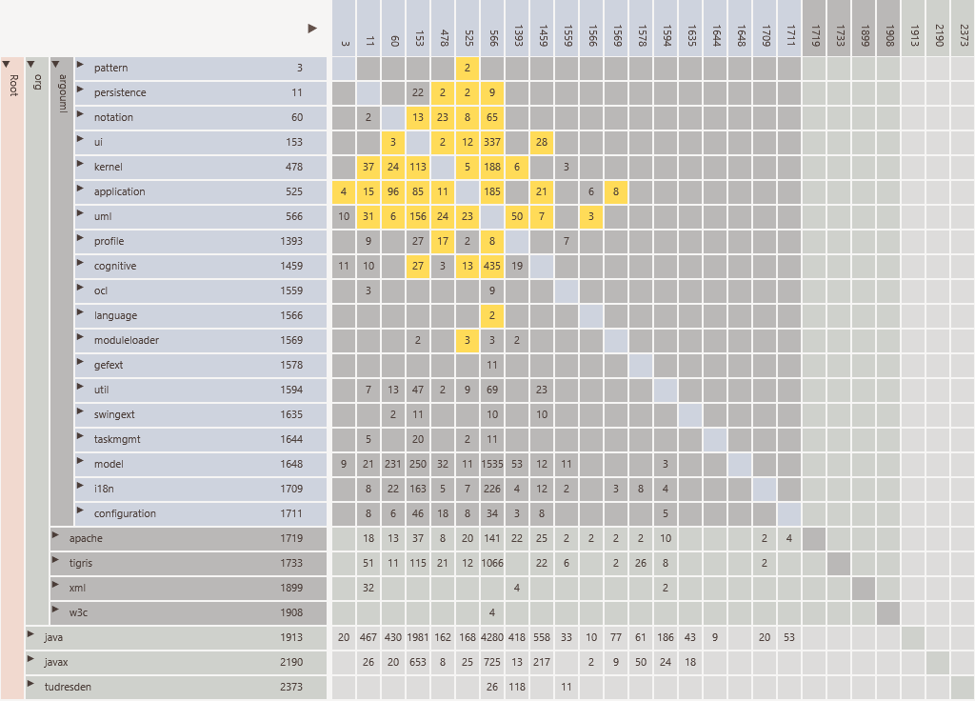
Notes:
As can be see there are many cyclic dependencies. Implementation clearly does not follow layered design.

Slide 95
Notes:
We also analyse ArgoUML using Structure101.

Slide 96
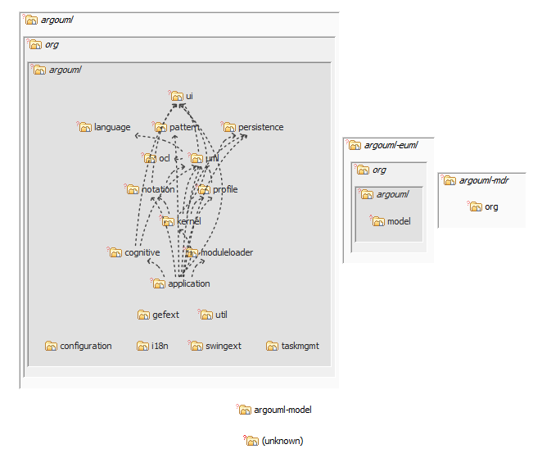
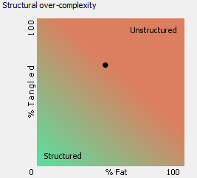
Notes:
This tools shows structure using a Leveled Sequence Map (LSM), which automatically layers elements in a diagram according to found dependencies.
Only relations against found layering are shown.
The tools also shows whether the software is structured or not.

Slide 97
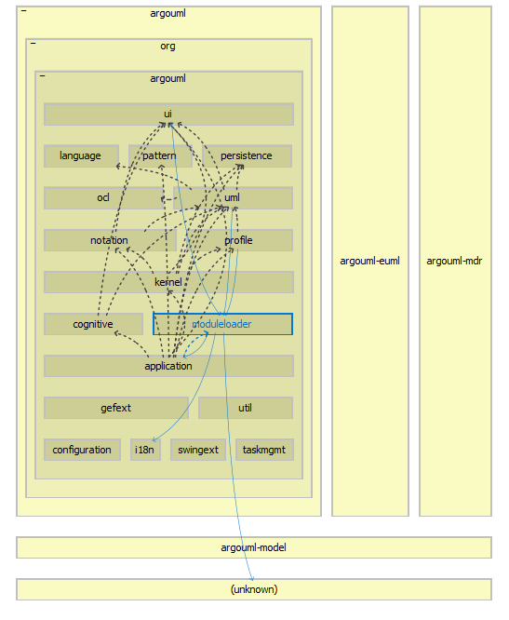
Notes:
Models can also be edited for refactoring impact analysis.

Slide 98
DEMO

Slide 99
Telegram
Notes:
The next application we look at is the open source desktop application of telegram.

Slide 100
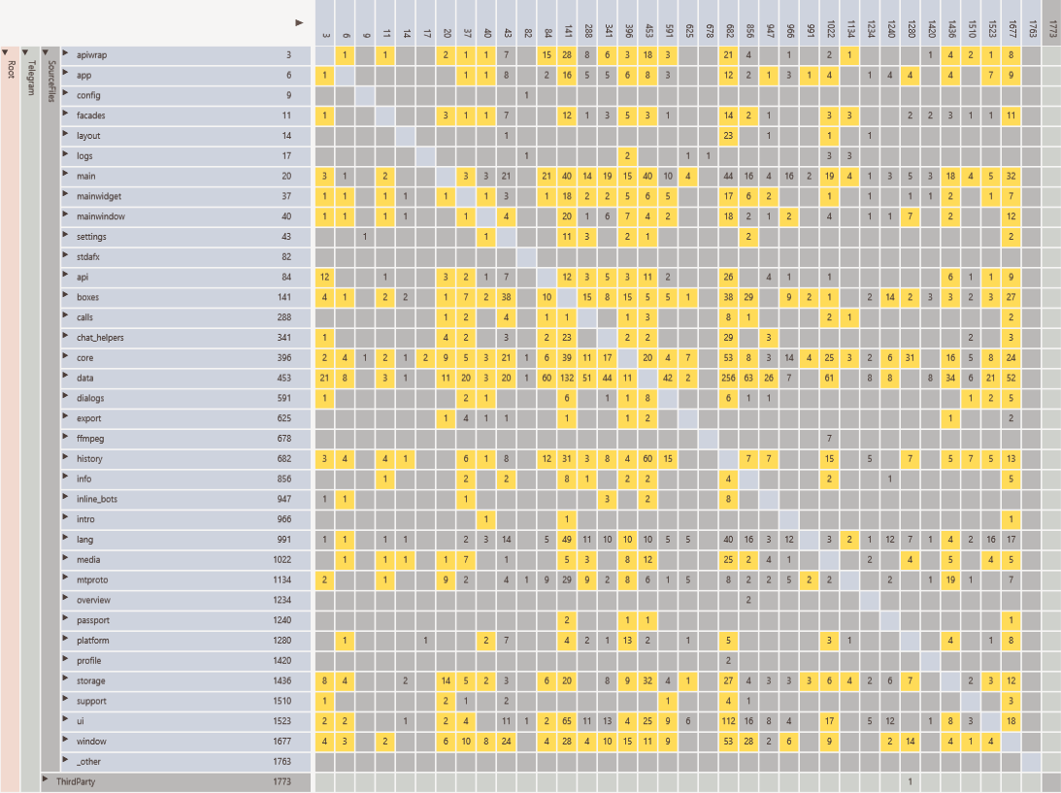
Notes:
At the top level it shows many packages having heavy cyclic dependencies.

Slide 101
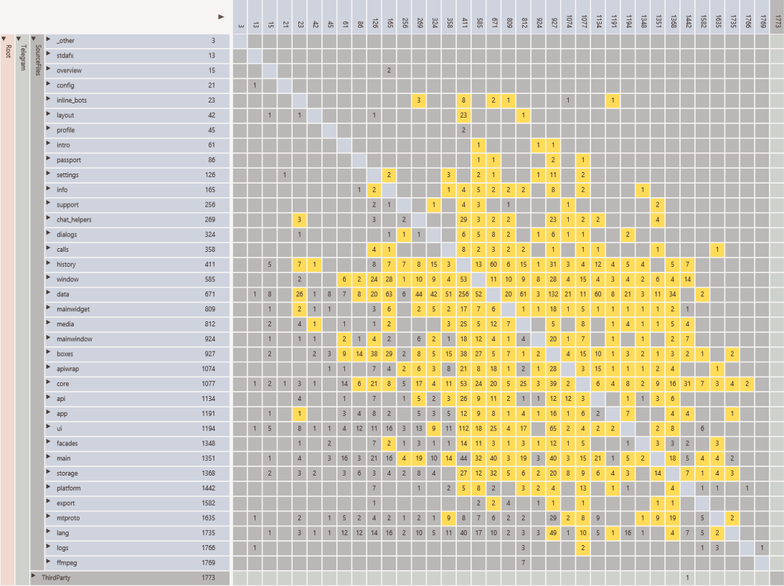
Defect here
Notes:
Using a portioning algorithm we can find the layering.
The resulting structure is clearly the result of the lack of visibility of the dependency structure.
No developer, expect one who is totally evil, would intentionally design it like this.
No imagine there is a defect in a core element and it is in the element itself or one of its dependants.

Slide 102
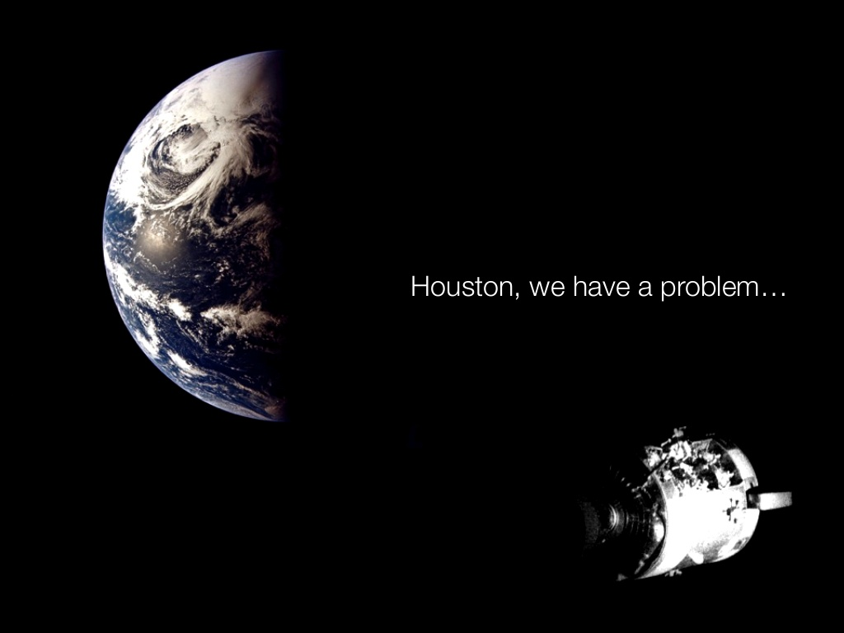
Notes:
Finding that could be really difficult.

Slide 103
Poco
Notes:
An next example is Poco, which is an open source C++ framework.

Slide 104
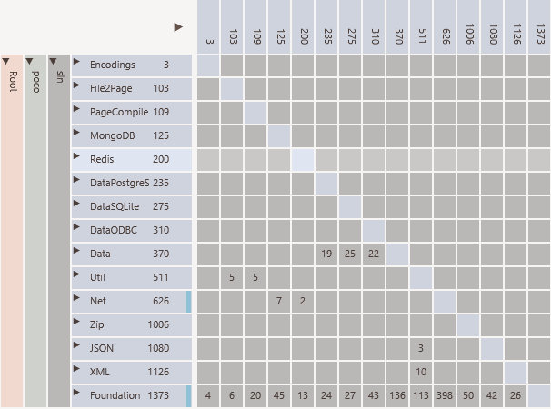
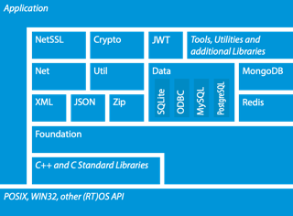
Not
in DSM
Not in diagram
MySQL missing
Not suggested by diagram
Suggested by diagram
Notes:
You see some mismatches between the documentation and the actual code.

Slide 105
Qt
Notes:
Now we look at QT.

Slide 106
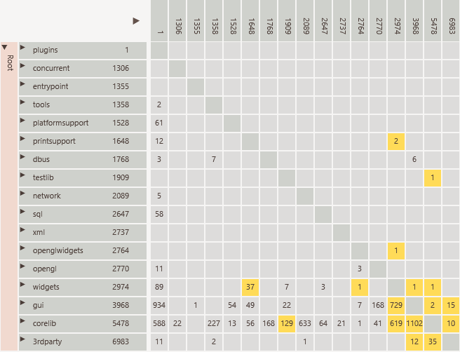
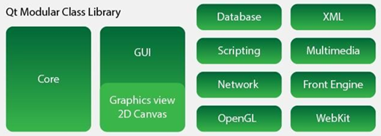
Not in diagram
Network, database, xml
GUI
Third party depends on QT
Notes:
Again we see some mismatches between the documentation and the actual code.

Slide 107
Linux Kernel

Slide 108
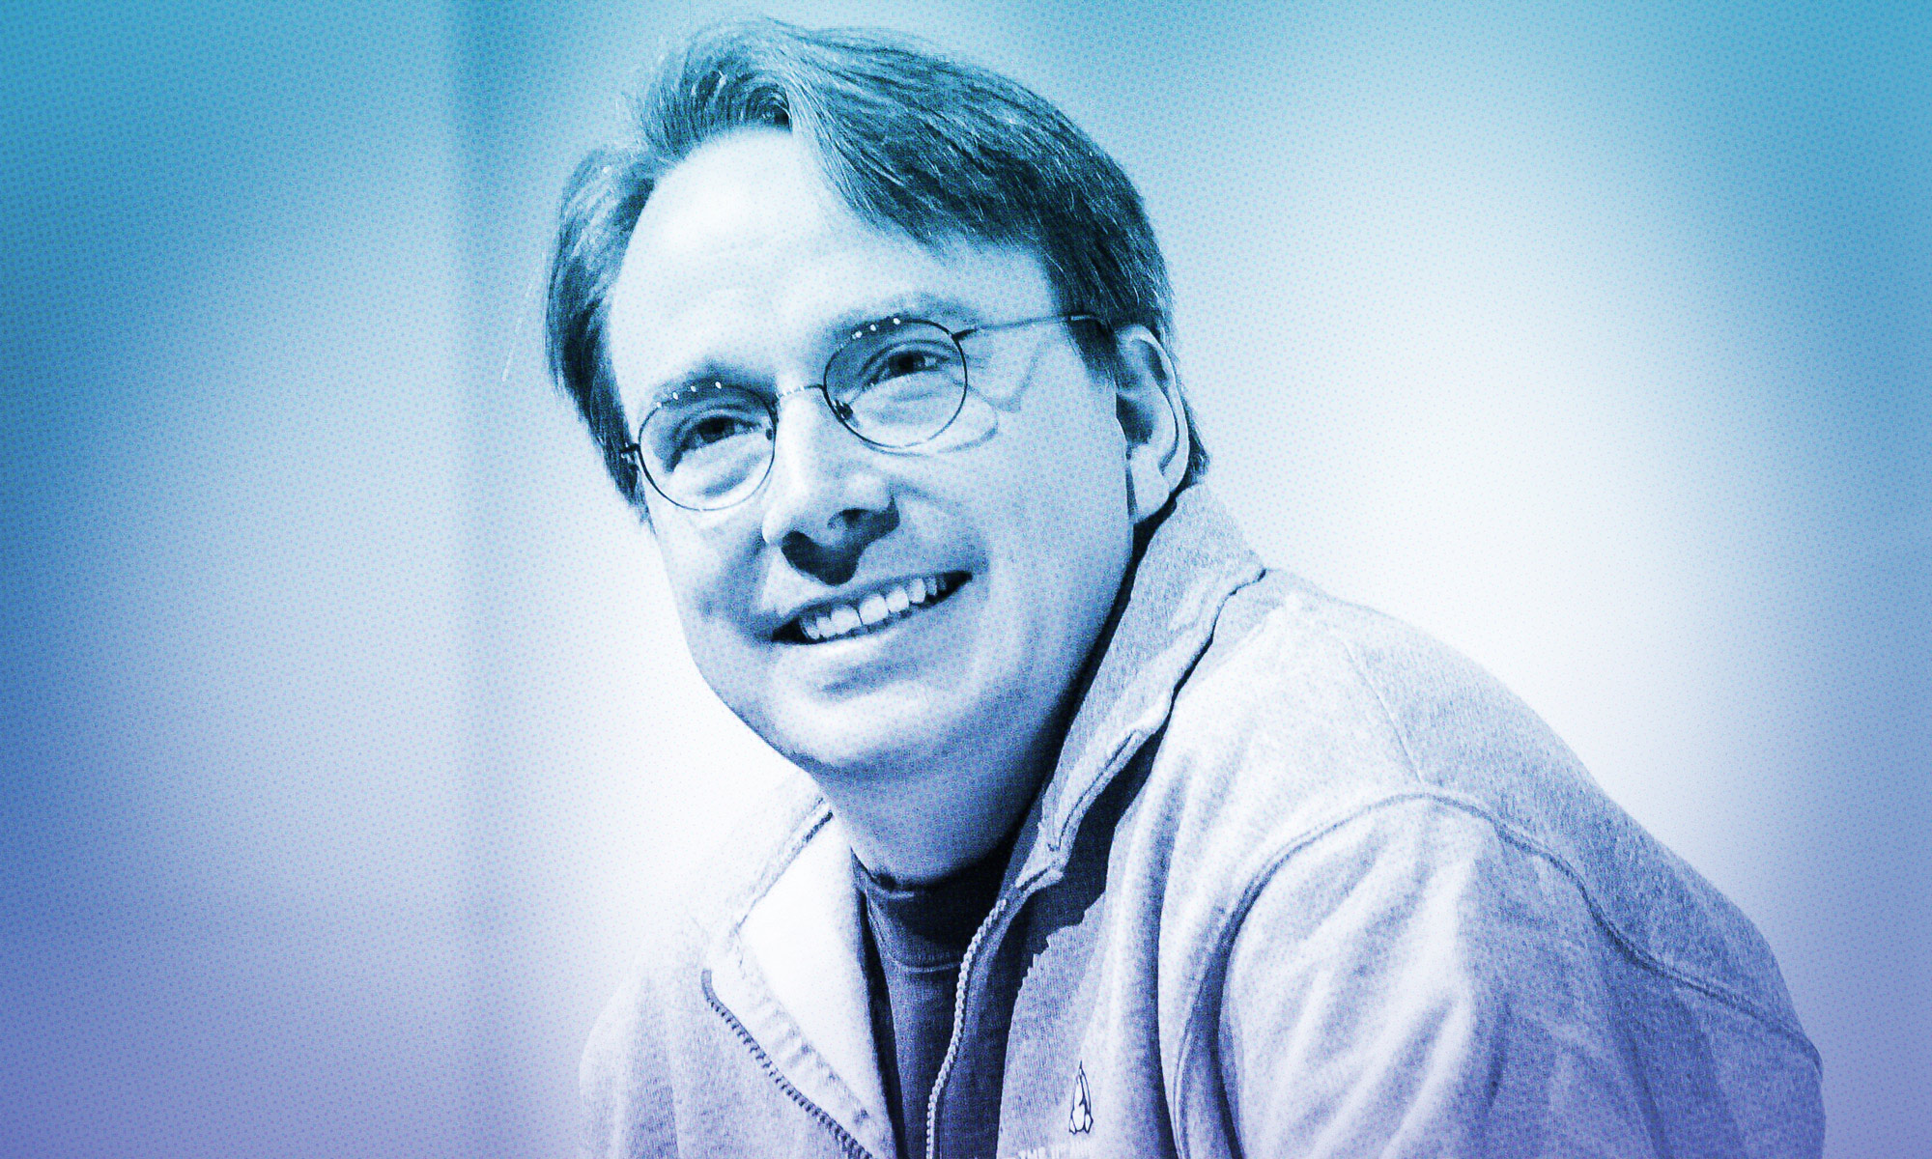
Linus Torvalds on where Rust will fit into Linux
Torvalds thinks "Rust's primary first target seems to be drivers, simply because that's where you find just a lot of different possible targets, and you have these individual parts of the kernel that are fairly small and independent.
Kroah-Hartman agrees that "drivers are probably the first place for an attempt like this as they are the 'end leafs' of the tree of dependencies in the kernel source. They depend on core kernel functionality, but nothing depends on them."
What to expect
Notes:
When integrating the Rust progamming language in Linux the drivers section is considred a good candidate.
https://www.zdnet.com/article/linus-torvalds-on-where-rust-will-fit-into-linux/

Slide 109
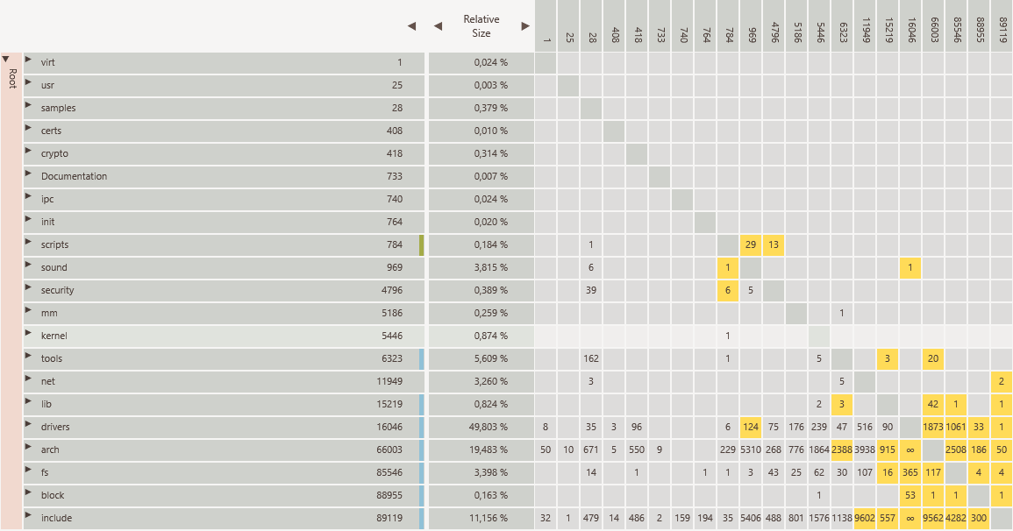
Notes:
Drivers seems indeed not very tightly coupled.
There seems to be some level of cyclic dependencies (was not able to fully parse the code successfully, so not fully sure)

Slide 110
DEMO

Slide 111
Notes:
Next we look at SCITools Understand. This tool was used by Lattix for C/C++ source code analysis. Still used by Structure101 for that purpose.
It is an developer oriented tool and not specifically for architects.

Slide 112
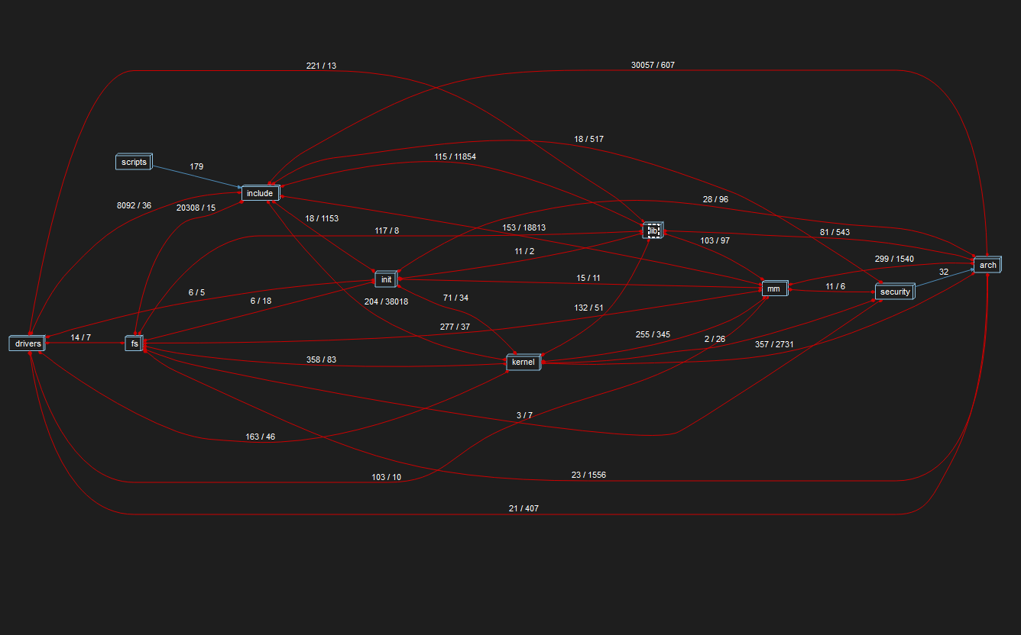
Notes:
It confirms the cyclic dependencies within the Linux software.

Slide 113
DEMO

Slide 114
Analysis Spring Framework
Notes:
Finally we look at the spring framework

Slide 115
The Spring development team manages software dependencies currently using Structure101
What to expect
Notes:
https://www.infoq.com/presentations/code-organization-large-projects/
It actively manages software dependencies using Structure101.

Slide 116
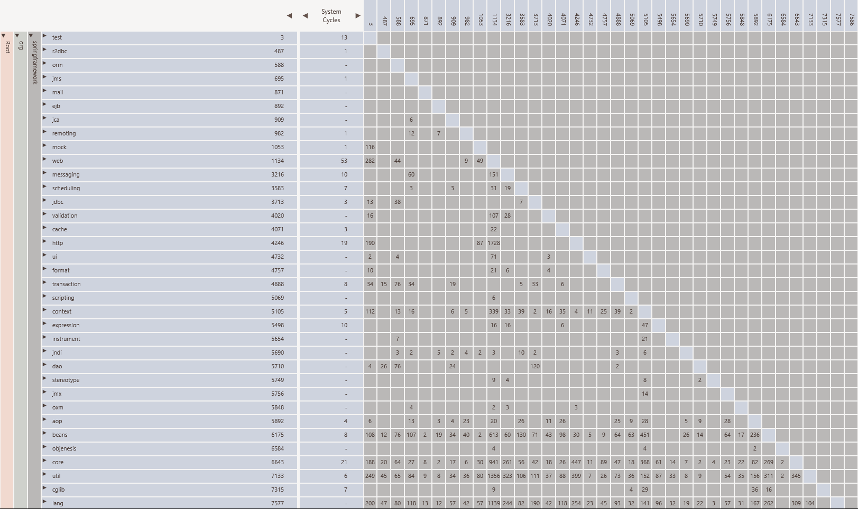
Notes:
We see a very clear architecture with any cyclic dependencies.
This is clearly not accident, but he result of actively managing dependencies.

Slide 118
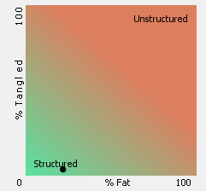
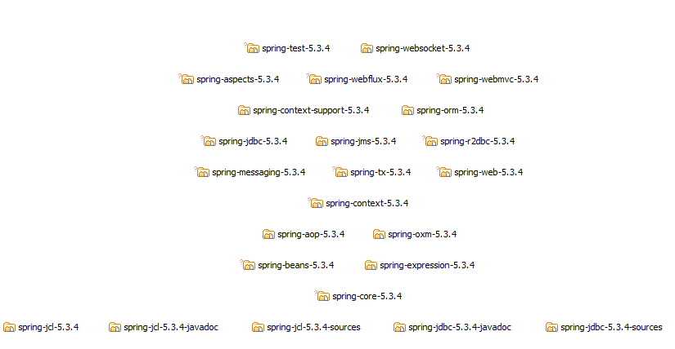
Notes:
We see the same using Structure 101.

Slide 119
DEMO

Slide 120
Summary

Slide 121
It matters
Code complexity often not visible
Can be very expensive
Active management is required
Visualization can help.

Slide 122

At what level can it be applied ?
Notes:
Tools can be used at all levels to improve modularity:
For large modules or files by analysing internal dependencies and decide based on that how to split up the module or file.
At component level.
At architectural level.

Slide 123

Best time to start ?
Notes:
It is best to start earlier in the development of the software when possible.
Visualizing dependencies allows you to quickly spot when you get often track.
It is like choosing the wrong path. The earlier you discover the less effort it is to return to the right track.

Slide 124

Notes:
Hope you enjoined this presentation and it helps you to develop cleaner code.

Slide 125

Any Questions

Slide 126


